Slide 1
Crux Lecture -16
Data Structures -4
Trees -2
Notes:
File Handling
Linked list code

Slide 2
Binary Trees
Notes:
Make them create one file from next time

Slide 3
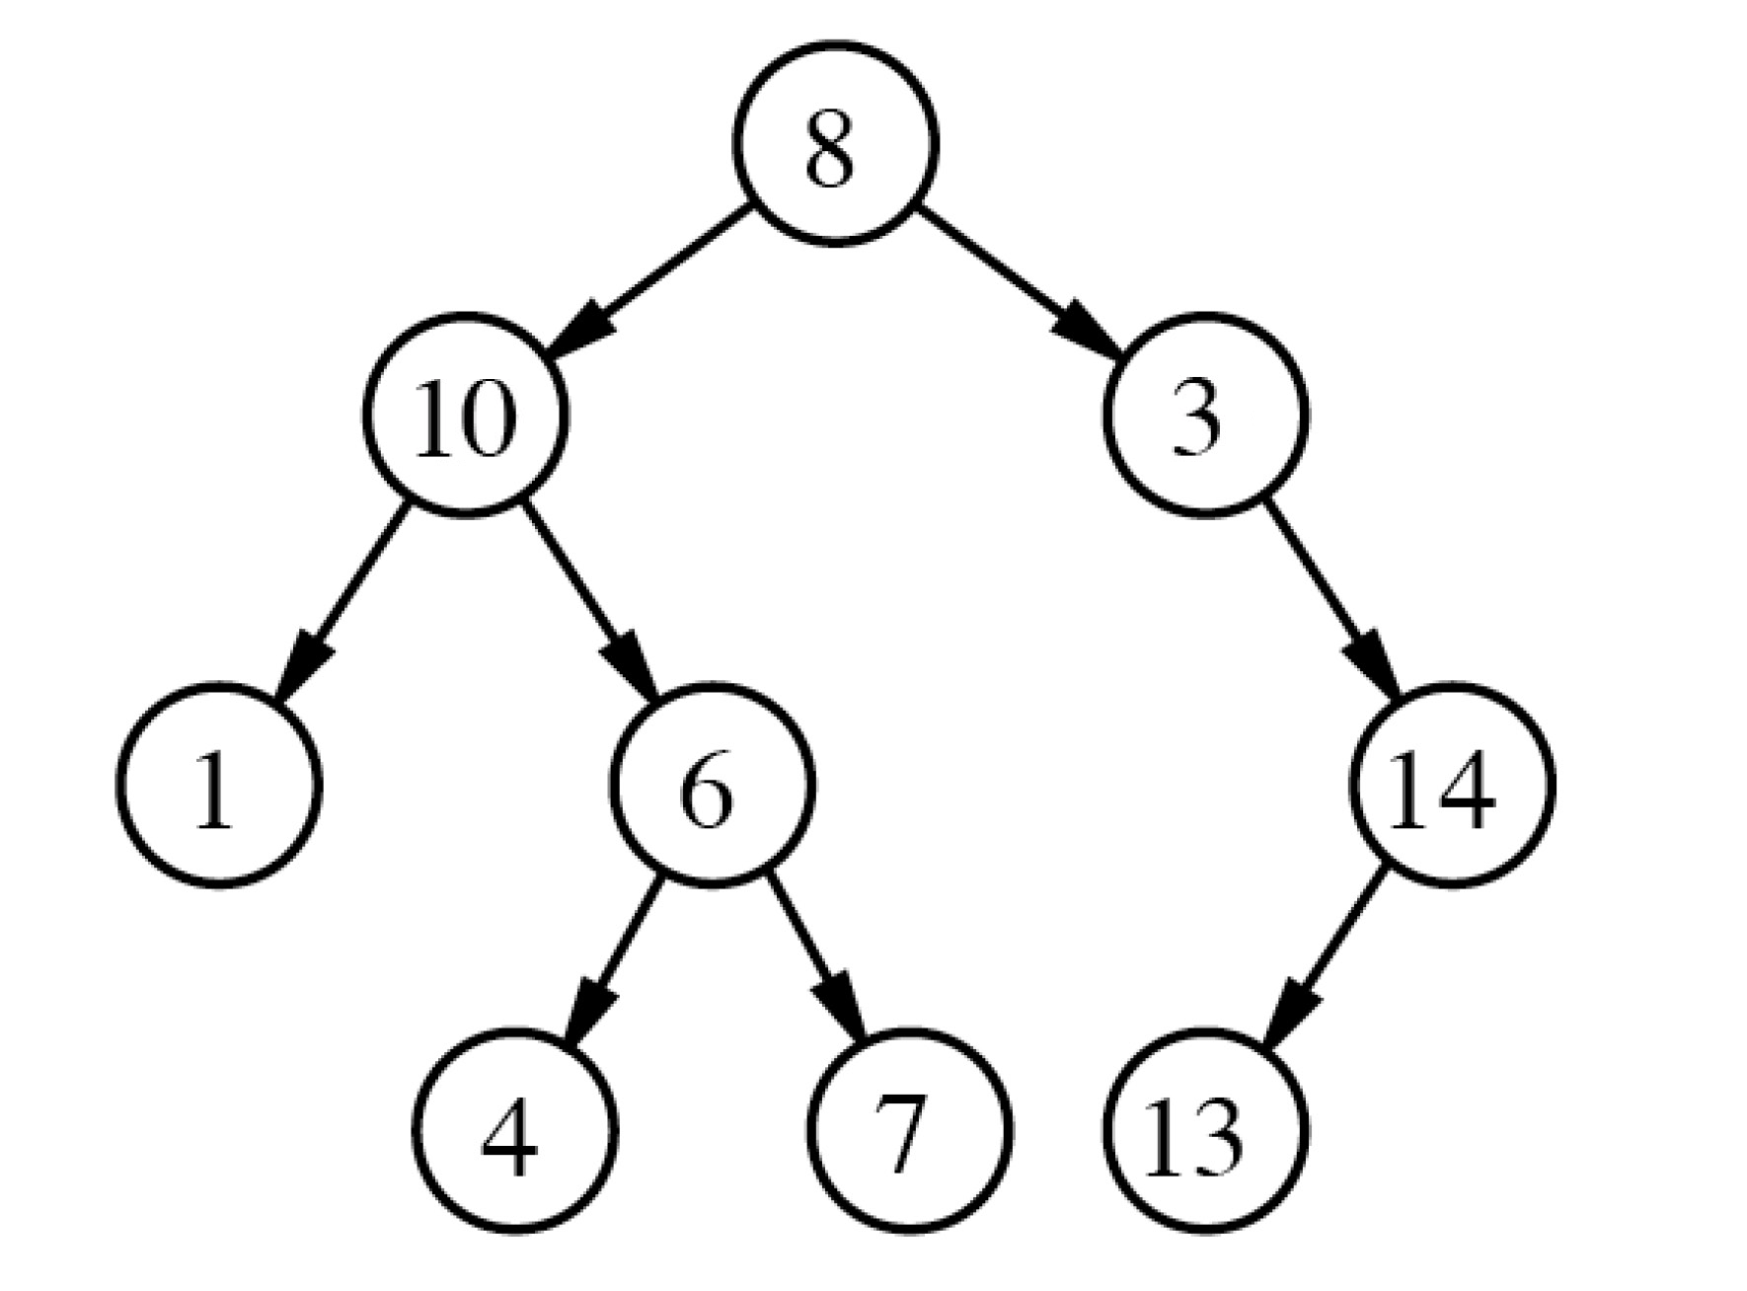
Binary Trees
Notes:
Talk about circular linked list

Slide 4
Binary Tree Node
Public class node{
int data;
node left;
node right;
}
Notes:
Talk about circular linked list

Slide 5
Lets discuss a problem
Find diameter of a binary tree
Notes:
Talk about circular linked list

Slide 6
Your Turn
Find a node in Binary Tree
Mirror a binary tree
Notes:
Talk about circular linked list

Slide 7
Another Traversal for Binary Trees
Inorder Traversal
Notes:
Talk about head of linkedlist

Slide 8

Thank You!
Rishab Kapoor
Rishab.Kapoor.29@gmail.com

